Slide 1
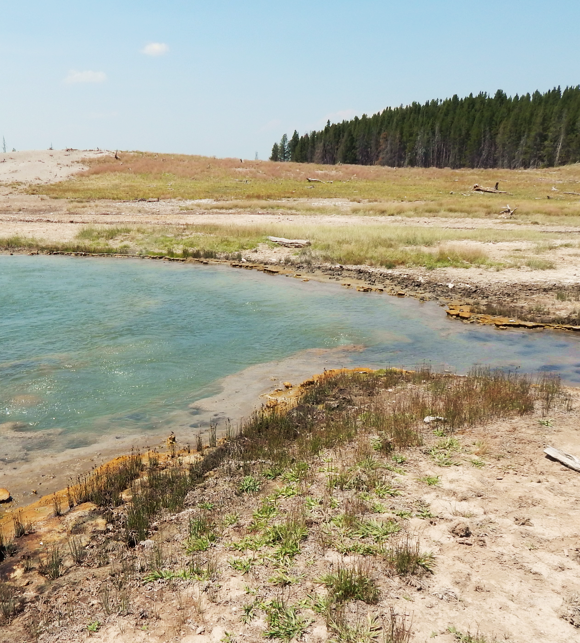





MEALS for Microbes: How do energy supplies of hot springs vary with where the water’s been?
Yellowstone National Park
Sien Smania
Dr. Everett Shock, Director

Slide 2




How are hot springs formed?
Starts as meteoric water (rain or snow)
Either:
  Short residence time
  Long residence time
  Hypothesis: The length of the residence time changes the chemistry of a system
Heat source

Slide 3

Why do I care?
Microbes!!!
Chemosynthesis via redox reactions
Question: Does this affect the reactions available for microbes?
Heat source

Slide 4
Why should YOU care?
Astrobiological implications
  The path that water takes can change its chemistry
  Finding measurable variables that predict this change
Climate change implications
  Fluctuations in rainfall snowmelt
  How are microbial communities and geochemical cycles affected?
Heat source

Slide 5
Choosing a parameter to track this
Water moves through rock, ions are leeched
  Chloride (Cl⁻)
Heat source

Slide 6
Choosing a parameter to track this
Water moves through rock, ions are leeched
  Chloride (Cl⁻)
Rain and snow have VERY low chloride concentrations
Heat source

Slide 7
Choosing a parameter to track this
Water moves through rock, ions are leeched
  Chloride (Cl⁻)
Rain and snow have VERY low chloride concentrations
Low chloride
High chloride
Heat source

Slide 8
Choosing a parameter to track this
Water moves through rock, ions are leeched
  Chloride (Cl⁻)
Rain and snow have VERY low chloride concentrations
Average Cl⁻ conc. = 0.00481 mol/kg
Low chloride
High chloride
Heat source

Slide 9
Choosing a parameter to track this
Water moves through rock, ions are leeched
  Chloride (Cl⁻)
Rain and snow have VERY low chloride concentrations
Average Cl⁻ conc. = 0.00481 mol/kg
  For analysis:
  Springs > 0.00481 mol/kg = chloride-rich
  Springs < 0.00481 mol/kg = chloride-poor
Low chloride
High chloride
Heat source

Slide 10
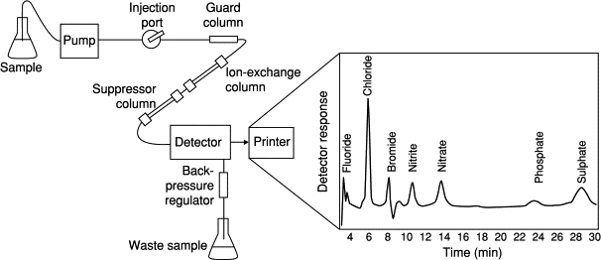
How Are ions measured?
1,627 samples with usable IC data from 1999-2014
Ion chromatography (IC)
(hot spring)
In the end we get a mol/kg value for each ion in a sample

Slide 11
What chemical reactions provide the most energy to the microbes in each spring type?

Slide 12
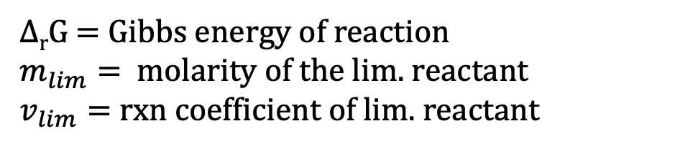
1,627 samples with usable IC data from 1999-2014
∆_{r}G = Gibbs energy of reaction
$m_{lim}=$molarity of the lim. reactant
$v_{lim}=$ rxn coefficient of lim. reactant
Eq. 1 $E= \frac{−∆_{r}G∗m_{lim}}{v_{lim}}$ where,

Slide 13
1,627 samples with usable IC data from 1999-2014
∆_{r}G = Gibbs energy of reaction
$m_{lim}=$molarity of the lim. reactant
$v_{lim}=$ rxn coefficient of lim. reactant
Eq. 1 $E= \frac{−∆_{r}G∗m_{lim}}{v_{lim}}$ where,
Water
Organic
Rock
Microbe

Slide 14
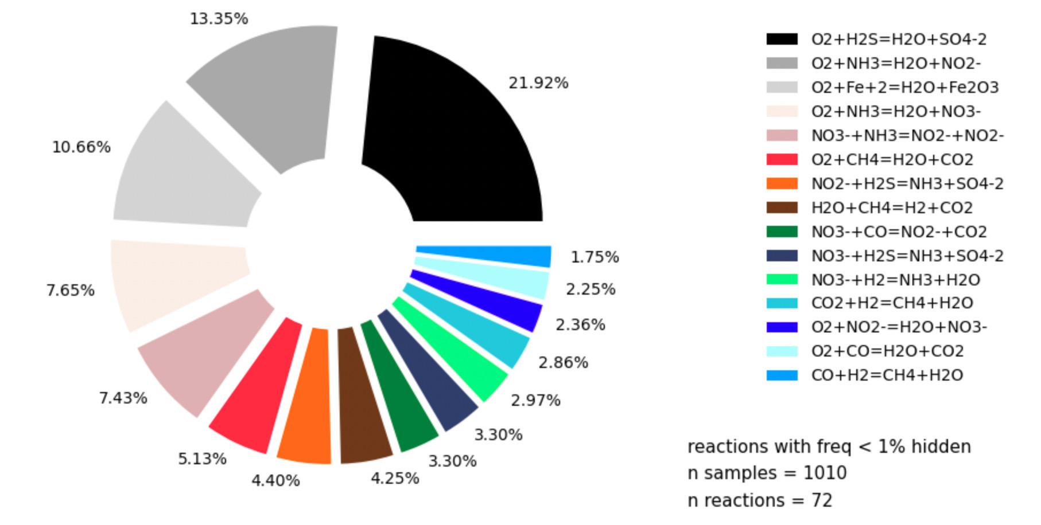
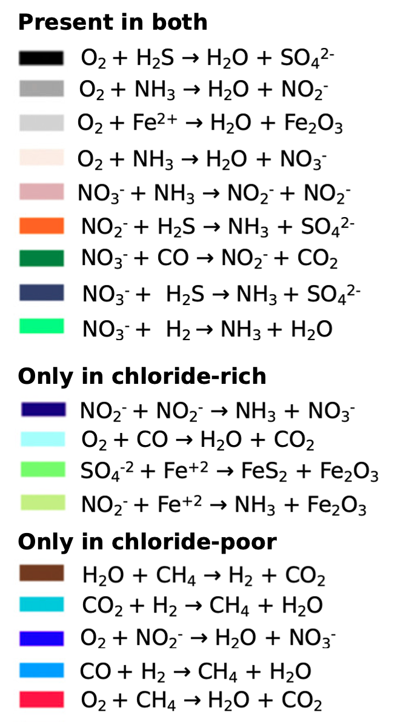
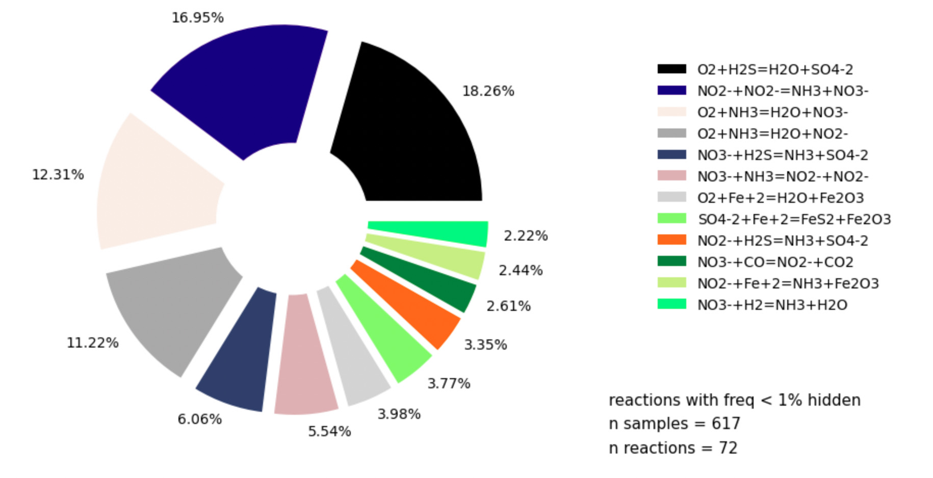
*Note: these equations are not balanced
% = Percent of time that this reaction is the highest energy producer in its system
Chloride-rich
chloride-poor
Chloride-poor
chloride-rich .

Slide 15
*Note: these equations are not balanced
% = Percent of time that this reaction is the highest energy producer in its system
Chloride-rich
chloride-poor
Chloride-poor
chloride-rich .

Slide 16
*Note: these equations are not balanced
% = Percent of time that this reaction is the highest energy producer in its system
Chloride-rich
chloride-poor
Chloride-poor
chloride-rich .

Slide 17
*Note: these equations are not balanced
% = Percent of time that this reaction is the highest energy producer in its system
Chloride-rich
chloride-poor
Chloride-poor
chloride-rich .

Slide 18
*Note: these equations are not balanced
% = Percent of time that this reaction is the highest energy producer in its system
Chloride-rich
chloride-poor
Chloride-poor
chloride-rich .

Slide 19
*Note: these equations are not balanced
% = Percent of time that this reaction is the highest energy producer in its system
Chloride-rich
chloride-poor
Chloride-poor
chloride-rich .

Slide 20
*Note: these equations are not balanced
% = Percent of time that this reaction is the highest energy producer in its system
Chloride-rich
Sulfur species
Ammonia
Methane
Iron species
chloride-poor
Chloride-poor
chloride-rich .

Slide 21
*Note: these equations are not balanced
% = Percent of time that this reaction is the highest energy producer in its system
Chloride-rich
Sulfur species
Ammonia
Methane
Iron species
chloride-poor
Chloride-poor
chloride-rich .
Methanogenesis AND methane oxidation
Methane cycling?

Slide 22
”WHERE THE WATER HAS BEEN” MEANS SOMETHING!
Sulfide oxidation and ammonium oxidation and denitrification are important for both water types
Springs with less meteoric input (more chloride) get more energy from methane reactions
Springs with more meteoric input (less chloride) get more energy from iron oxidation
Naeth, M. A., Bailey, A. W., Chanasyk, D. S., & Pluth, D. J. (1991). Water holding capacity of litter and soil organic matter in mixed prairie and fescue grassland ecosystems of Alberta. Rangeland Ecology & Management/Journal of Range Management Archives, 44(1), 13-17.
Throop, H. L., & Belnap, J. (2019). Connectivity dynamics in dryland litter cycles: Moving decomposition beyond spatial stasis. BioScience, 69(8), 602-614.

Slide 23
BIOLOGY QUESTIONS
Are there more methane oxidizing bacteria and methanogens in high-chloride (long residence) systems?
Are there more iron oxidizers in low-chloride systems?

Slide 24
Questions?

Slide 25
Thank you ☺

